Slide 1
ATS overview
Alliance Theological Seminary (ATS) Background
About MINTS – the Franchise Model
Getting a Center Started
Questions?

Slide 2
Alliance theological seminary
ATS Background
Founded in 2022
A long-term vision that God has brought together
Support from Pastors and the Men’s Ministry

Slide 3
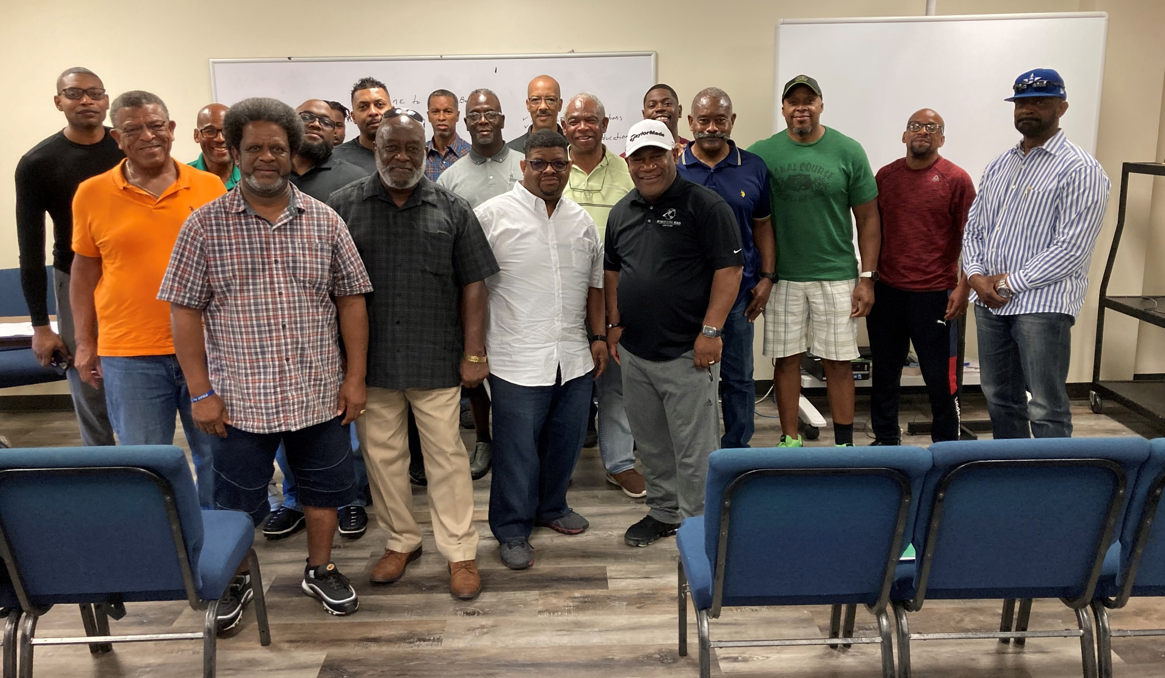
Alliance theological seminary – 1st Information Mtg, May 2022

Slide 4
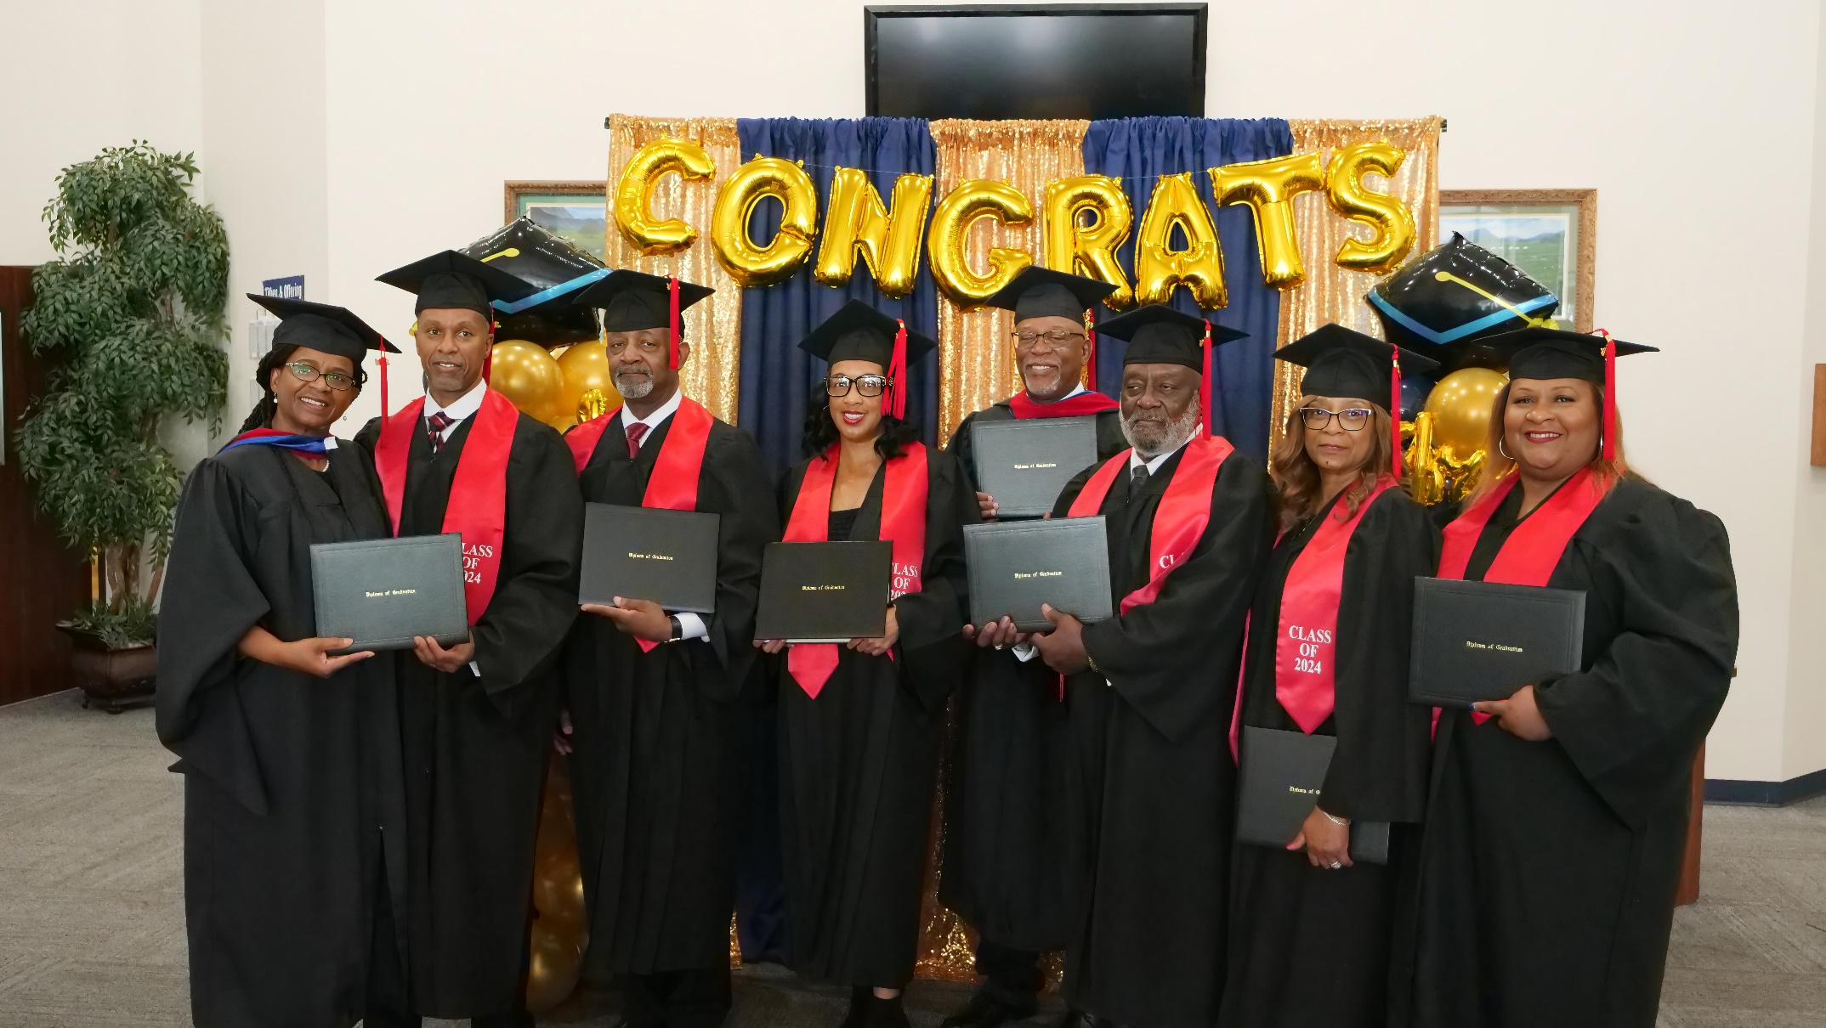
Alliance theological seminary – 1st Graduation, May 18 2024

Slide 5
MINTS International Seminary estD. 2000
ATS is a franchise of:
www.mints.edu

Slide 6
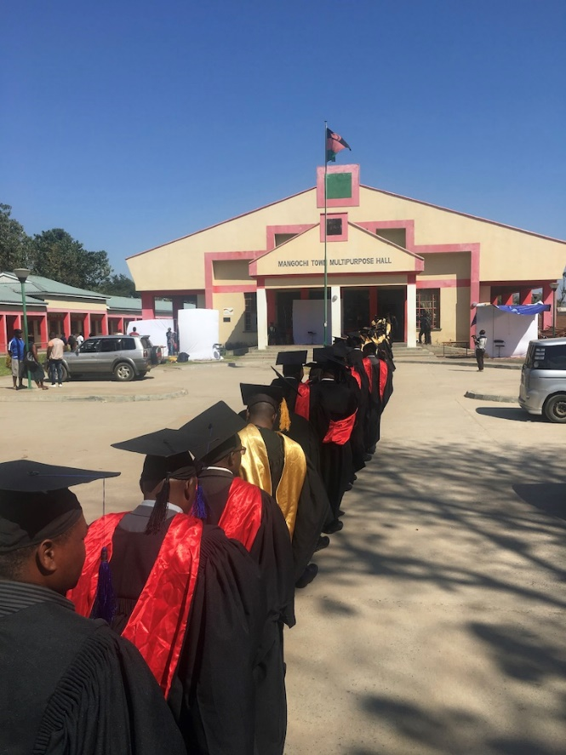
Making Disciples In All Nations
Teaching
Them THE
Truth
Sending Them Out
A Biblical Mission-Seminary

Slide 7
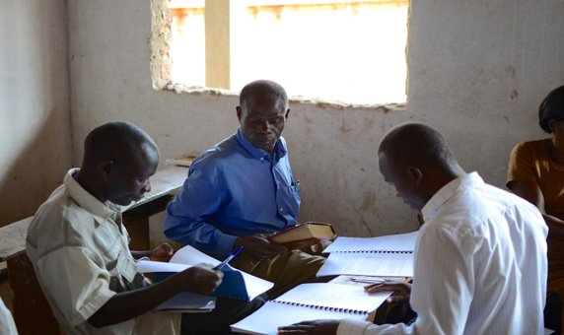
The Great Missionary Challenge: Matthew 28:18-20
… equipping pastors and teachers to extend God’s Kingdom.
Notes:
Why MINTS
The challenge is before us. –
To Spread the (Reformed) Faith
All nations
build up the saints (teaching ministers)
Extend the Kingdom of God to Christ’s glory

Slide 8
The Great Missionary Challenge – TheologiCal education
2 Timothy 2:2
Based on Relationships
Hebrews 5:11-14
Wanting to deliver “solid food”
Notes:
Why MINTS
The challenge is before us. –
To Spread the (Reformed) Faith
All nations
build up the saints (teaching ministers)
Extend the Kingdom of God to Christ’s glory

Slide 9
The Great Missionary Challenge – TheologiCal education
But CHALLENGES,
Colossians 2:6-10 secular philosophy (1 Corinthians 1:18-31)
1 Timothy 1:3-4 "seminary" philosophy
IN CONTRAST, 1 Timothy 1:5-7 and Luke 6:39-40 ff.
Notes:
Why MINTS
The challenge is before us. –
To Spread the (Reformed) Faith
All nations
build up the saints (teaching ministers)
Extend the Kingdom of God to Christ’s glory

Slide 10
The Great Missionary Challenge – TheologiCal education
The GOAL is “rightly handling the word of truth”
2 Timothy 2:14-15
Notes:
Why MINTS
The challenge is before us. –
To Spread the (Reformed) Faith
All nations
build up the saints (teaching ministers)
Extend the Kingdom of God to Christ’s glory

Slide 11
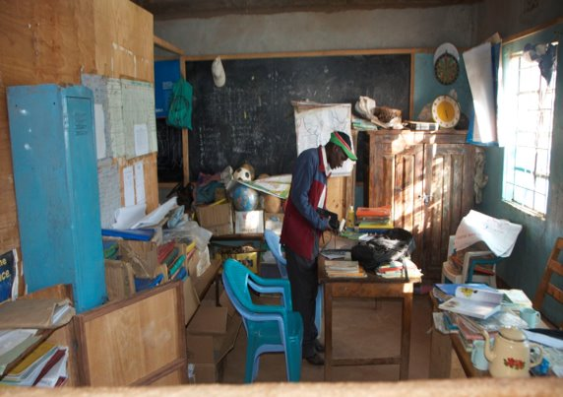
MINTS’ Global Challenge
95% of pastors worldwide are without training.
Notes:
Our Challenge:
95% of pastors worldwide are without training.
Current mission models cannot meet the need.

Slide 12
The MINTS Model
As soon as possible we train national students to write curriculum under our oversight so that a permanent training resource is developed in their language and culture which are then shared throughout the language group. When they graduate, they become the professors and start new schools.
National ownership and self-governance of the new schools instills excitement as the national believers work to promote and expand their own schools for their people. Multiplication is a key value.
MINTS promotes a different philosophy of education. It is a mindset that takes the education out to the people, to plant new schools, and to develop new national instructors.
Notes:
OUR PARTNERSHIP CONTRIBUTION
Registered University in Florida to Grant Degrees (structure, motivation, balance)
All Areas of Theological Study.
Biblical, Systematics, Mission, History, Pastoral
All Academic Levels
Certificate, BA, MA, D.Min., & Ph.D.
Provide MINTS curriculum on Web for World-Wide Access
www.mints.edu
Easy-free Delivery via PDF Download
Develop New Centers, Coordinate Centers, provide structure and accountability
Teach and Train the next generation of Teachers – MA teachers and DMin. (New writers)
Translate Materials for new AREAS AND Create Mini Libraries,

Slide 13
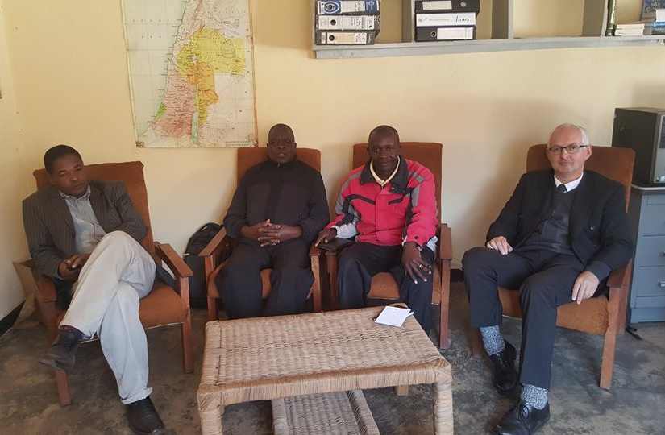
MINTS At Work…
Valid Degrees
Free Curriculum
Academic Structure and Accountability
Training the Next Generation
Materials Translation
Notes:
OUR PARTNERSHIP CONTRIBUTION
Registered University in Florida to Grant Degrees (structure, motivation, balance)
All Areas of Theological Study.
Biblical, Systematics, Mission, History, Pastoral
All Academic Levels
Certificate, BA, MA, D.Min., & Ph.D.
Provide MINTS curriculum on Web for World-Wide Access
www.mints.edu
Easy-free Delivery via PDF Download
Develop New Centers, Coordinate Centers, provide structure and accountability
Teach and Train the next generation of Teachers – MA teachers and DMin. (New writers)
Translate Materials for new AREAS AND Create Mini Libraries,

Slide 14
MINTS Degree Programs
• CTS: Certificate for Theological Studies
• AATS: Associate of Arts in Theological Studies
• BATS: Bachelor of Arts in Theological Studies
• MATS: Master of Arts in Theological Studies
• M.Div: Master of Divinity
• D.Min: Doctor of Ministry
• Ph.D.: The Doctor of Philosophy
MINTS is an IRS 501(c)(3) non-profit educational ministry and is authorized by the Florida Department of Education's Council on Independent Education (CIE) to grant religious degrees.

Slide 15
MINTS Graduates by year
Numbers subject to revision after pandemic years are finalized

Slide 16
MINTS By-the-Numbers*
Courses Offered:
Associated Schools and Centers:
Degrees Awarded Since 2000:
Current Student Enrollment:
Material Languages :
Countries With Students:
Professors, Adjuncts and Coordinators:
256
220+
5209+
2200+
11
50+
180+
*Numbers subject to revision after pandemic years are finalized

Slide 17
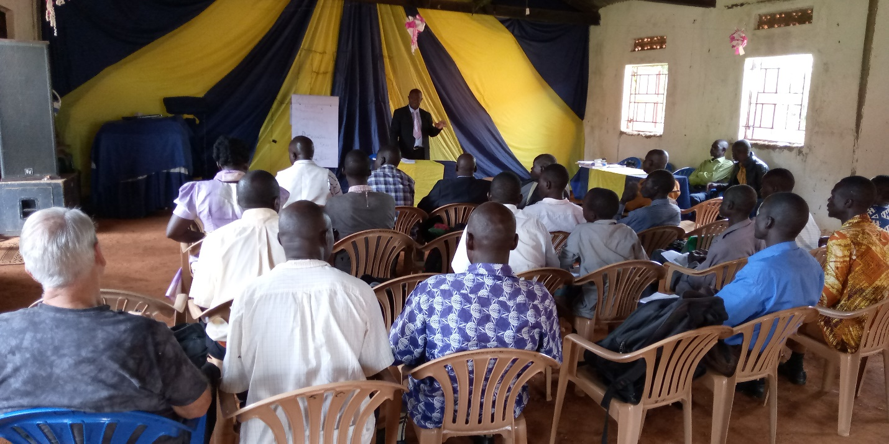
Isaac Mugerwa, MA, M.Div. Uganda
Graduating students become the teachers, using curriculum they’ve created.
Notes:
The MINTS Partnership
www.mints.edu
Teaching is done by visiting lecturers, and then the best MINTS students become indigenous missionaries using curriculum that they have created.
An Independent Future – Replicate and Replace
Create MINTS course writers (D.Min)
Create contextual courses for all areas of the world
Multiply local centers through the mission work

Slide 18
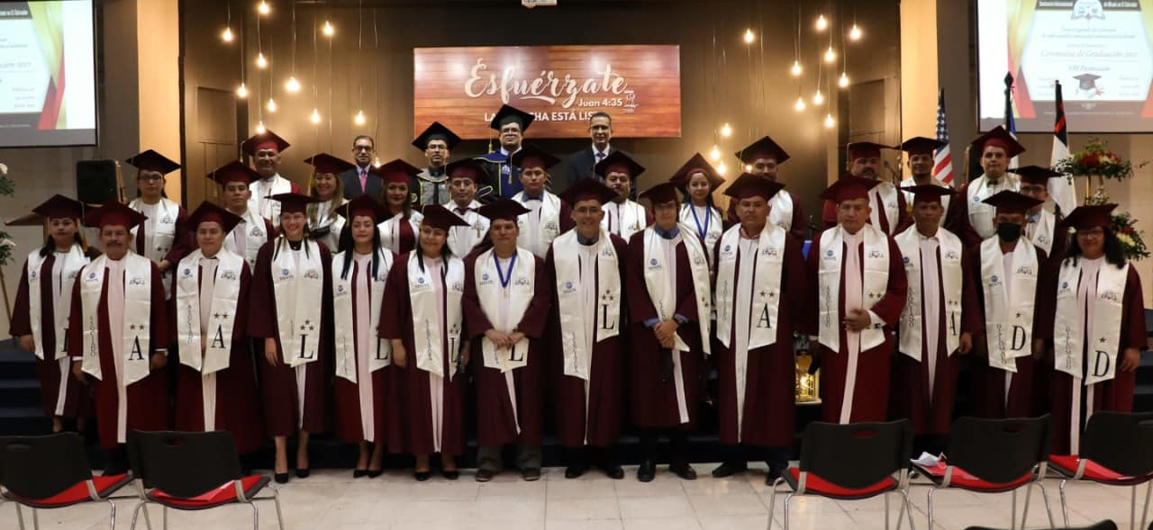
Graduacion de MINTS En el Salvador
Notes:
The MINTS Partnership
www.mints.edu
Teaching is done by visiting lecturers, and then the best MINTS students become indigenous missionaries using curriculum that they have created.
An Independent Future – Replicate and Replace
Create MINTS course writers (D.Min)
Create contextual courses for all areas of the world
Multiply local centers through the mission work

Slide 19
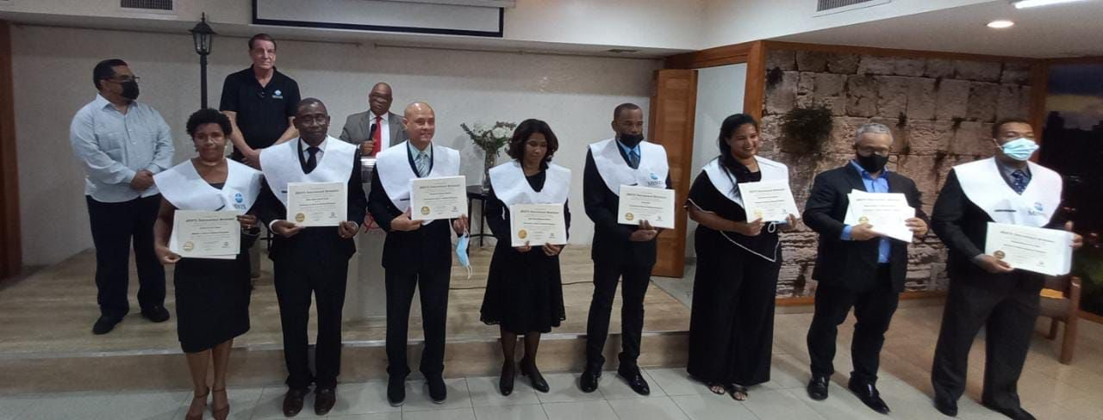
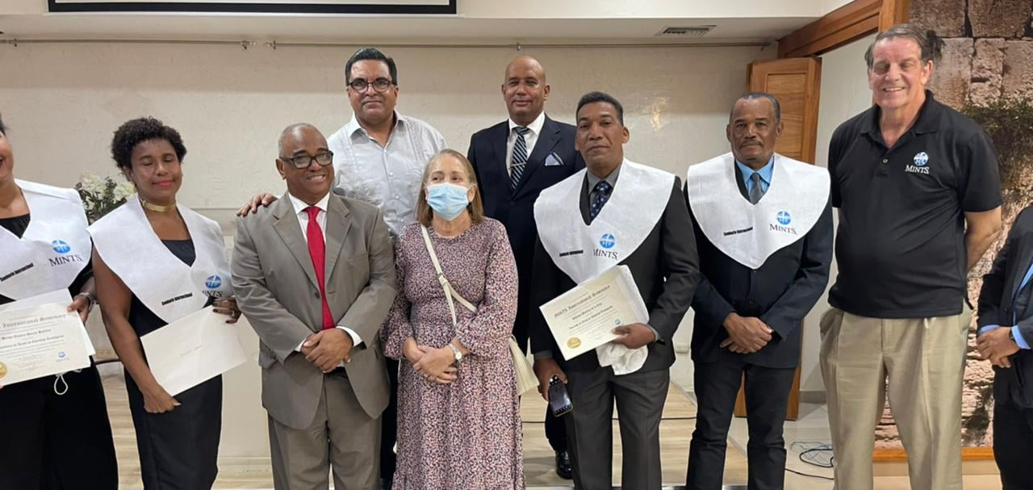
Graduacion de MINTS en Republica Dominicana
Notes:
The MINTS Partnership
www.mints.edu
Teaching is done by visiting lecturers, and then the best MINTS students become indigenous missionaries using curriculum that they have created.
An Independent Future – Replicate and Replace
Create MINTS course writers (D.Min)
Create contextual courses for all areas of the world
Multiply local centers through the mission work

Slide 20
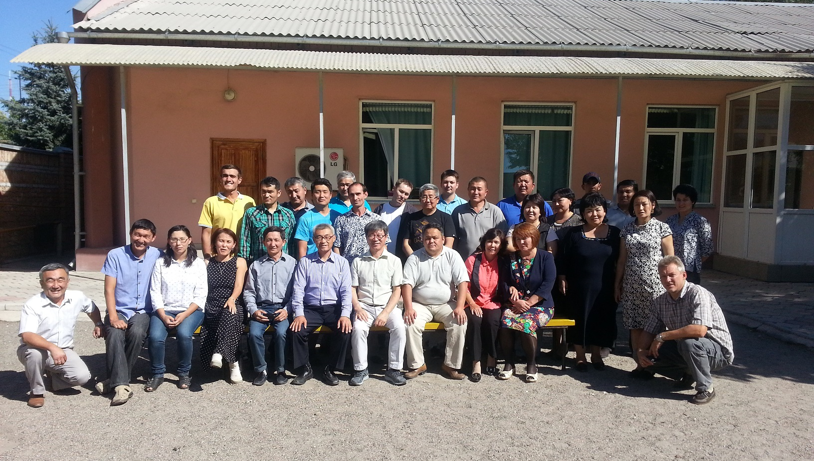
Union Theological Seminary, a MINTS partner in Central Asia

Slide 21
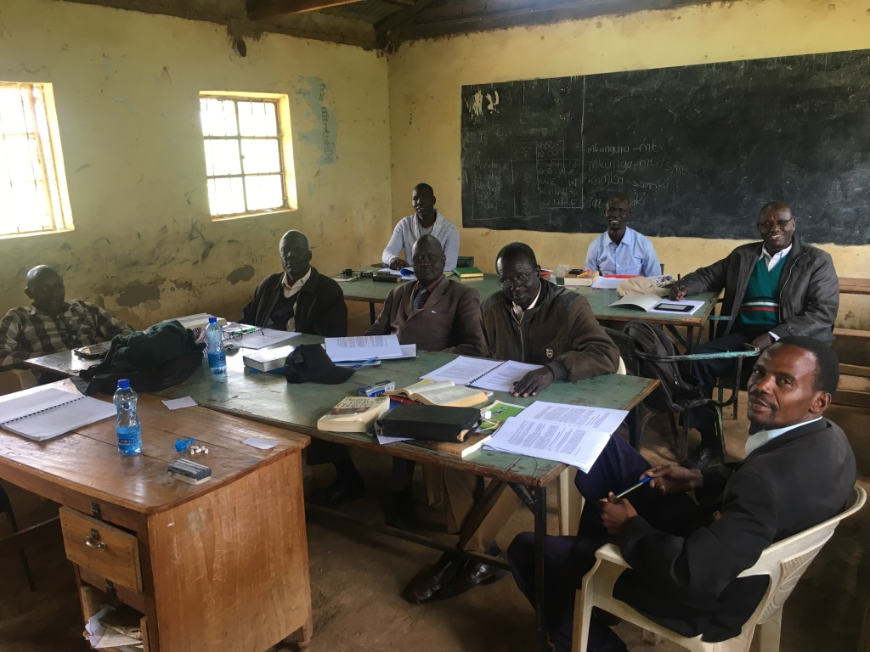
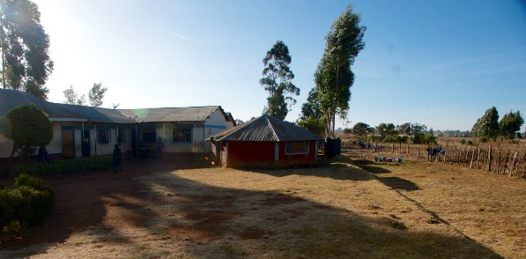
A MINTS classroom in Kenya
Notes:
Accessible - Local Centers
Students don’t have to leave families, churches, and businesses.
Affordable - No Overhead = No Overhead Costs
Local centers use homes, churches, and schools.
They are not dependent on western aid and control.
Autonomous
Centers are self-governed using MINTS principles in the areas of administration and finance.
The MINTS Partnership
www.mints.edu
Teaching is done by visiting lecturers, and then the best MINTS students become indigenous missionaries using curriculum that they have created.
An Independent Future – Replicate and Replace
Create MINTS course writers (D.Min)
Create contextual courses for all areas of the world
Multiply local centers through the mission work

Slide 22
Starting a center
Identify a Study Center Coordinator (SCC) and Students (a minimum of eight)
Schedule class(es)
Determine charges (set by local center)
Sign up students
Carry out first class(es)
.

Slide 23
QUESTIONS?

